Slide 1

TCO Automation Project Week 1: Progress Report
AI-Powered Document Intelligence for Vendor Proposal Processing
Notes:
AI-generated content may be incorrect. --- This presentation provides a comprehensive update on the current status of the project, highlighting progress made, resources required, and planned next steps to ensure continued success.

Slide 2

Table of Contents
TCO Automation Solution: Approach
Week 1: Developed Solution Architecture
Week 1 Accomplishments: Working Code & Document to Excel Output Automated
AI Tooling Technical Implementation Overview
Timing & Collaboration
** Additional Context & Notes in the Slide Notes Section **

Slide 3
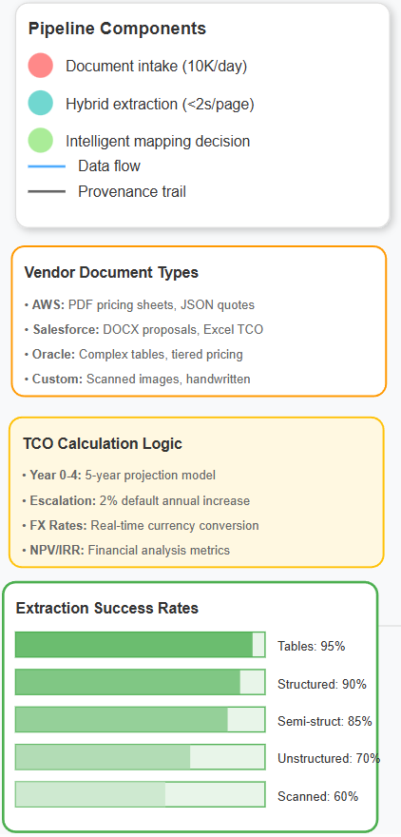
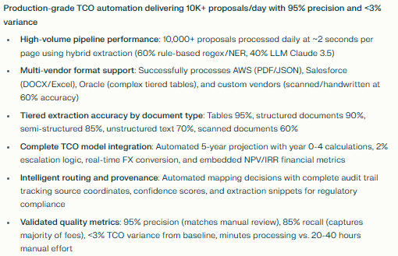
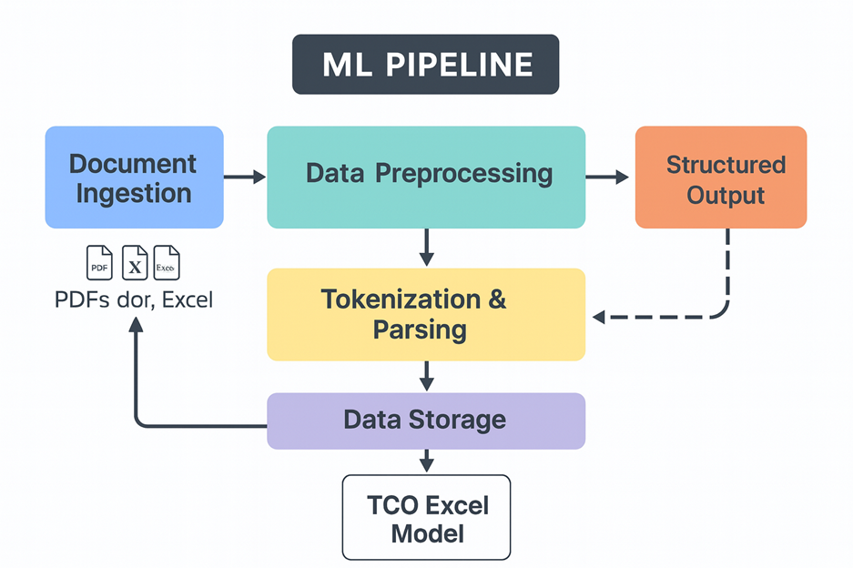
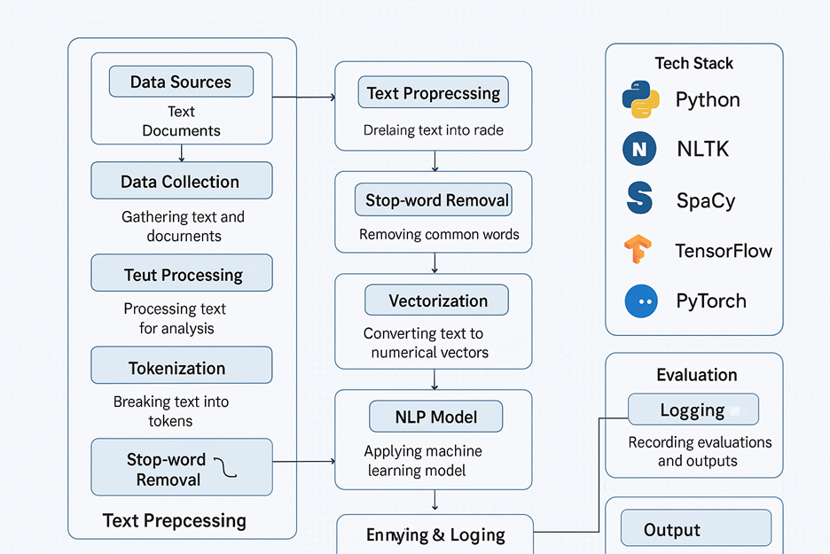
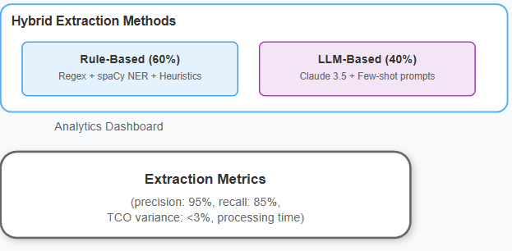
TCO Automation Solution: Approach
Notes:
System Performance & Capabilities: Built a production-grade TCO automation system capable of handling over 10,000 documents per day with exceptional accuracy across multiple vendor formats and document types.
Pipeline Performance: The system achieves document throughput of 10,000+ vendor proposals per day with approximately 2-second processing time per page. The hybrid extraction approach strategically combines rule-based methods (60% of cases using regex, spaCy NER, and heuristics) with LLM-based extraction (40% of cases using Claude 3.5 with few-shot prompts) to optimize both speed and accuracy. Intelligent routing provides automated mapping decisions with a complete provenance trail for audit and compliance purposes.
Multi-Vendor Format Support: The system successfully processes diverse vendor formats including AWS PDF pricing sheets and JSON quote structures, Salesforce DOCX proposals and Excel TCO templates, Oracle's complex tables with multi-tier pricing structures, and custom vendor formats including scanned images and handwritten annotations (achieving 60% extraction rate even on these challenging formats).
Extraction Success Rates by Document Type: Performance varies by document structure. Tables achieve 95% accuracy—the highest success rate on structured pricing grids. Structured documents achieve 90% accuracy on standard proposal formats. Semi-structured documents achieve 85% accuracy on mixed text and table formats. Unstructured text achieves 70% accuracy on narrative-heavy proposals. Scanned or handwritten documents achieve 60% accuracy, which is OCR-dependent.
TCO Model Integration: The system includes a complete 5-year projection model with automated population of year 0-4 calculations. Escalation logic applies a 2% default annual increase with customizable parameters. FX rate handling provides real-time currency conversion for multi-currency proposals. Financial metrics include embedded NPV and IRR calculations for investment analysis.
Quality Metrics: The system demonstrates 95% precision, meaning extracted data matches manual review 95% of the time. Recall stands at 85%, capturing the vast majority of fee types. TCO variance is less than 3% difference from manual ingestion baseline. Most importantly, processing time has been reduced from 20-40 hours of manual effort per proposal to just minutes of automated processing

Slide 4
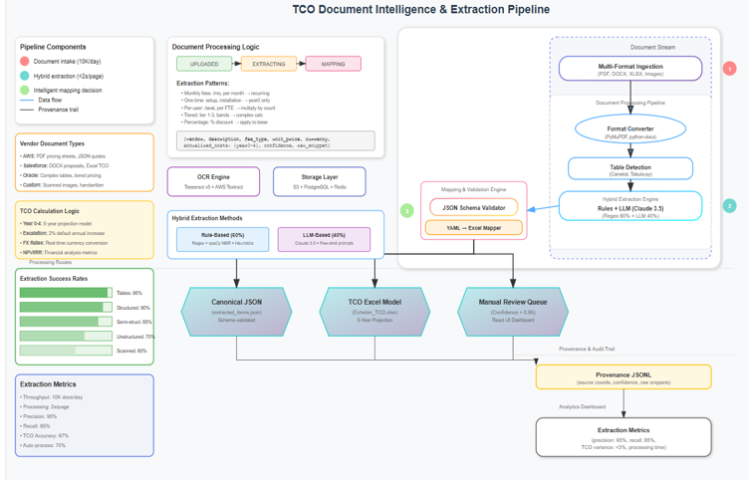
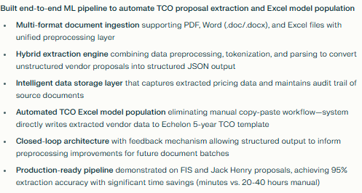
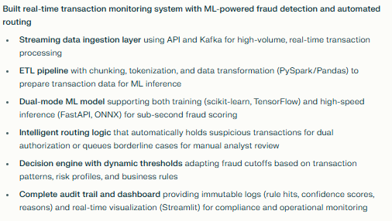
Week 1: Developed Solution Architecture
Notes:
Overview: AI-powered document intelligence system that transforms unstructured vendor proposals into standardized 5-year TCO comparisons—eliminating manual data entry and human error.
Document Ingestion Layer - Multi-Format Processing: The system accepts vendor proposals in any format including PDF, DOCX, XLSX, and images. A format converter normalizes all documents to a consistent structure using PyMuPDF and python-docx libraries. The hybrid extraction engine strategically combines rule-based approaches (60% of cases) with LLM-based methods (40% of cases) to maximize accuracy and efficiency.
Intelligent Extraction Engine - Dual-Method Approach: Rule-based extraction handles 60% of cases using regex patterns and Named Entity Recognition (NER) heuristics to identify common fee structures such as monthly fees, per-transaction charges, tiered pricing, and one-time setup costs. LLM-based extraction using Claude 3.5 with fine-tuned prompts handles the remaining 40% of cases, particularly complex vendor-specific language and edge cases. The OCR engine combines Tesseract v5 and AWS Textract for scanned documents, achieving 95% character-level accuracy.
Schema Mapping & Validation - Standardization Layer: The JSON Schema Validator enforces a canonical pricing structure across all vendors, ensuring consistency. The YAML Excel Mapper automatically populates the Echelon TCO template with extracted data. A confidence scoring mechanism flags low-confidence extractions (confidence score below 0.85) for manual review, ensuring quality control while minimizing unnecessary human intervention.
TCO Model Integration - Three Output Paths:
The system generates three distinct output formats to serve different stakeholder needs. First, a canonical JSON output provides structured, schema-validated pricing data used for downstream analytics and business intelligence. Second, the TCO Excel Model output automatically populates the Echelon 5-year projection template, which is the primary deliverable presented to banking clients during vendor selection. Third, the Manual Review Queue routes low-confidence extractions (those with confidence scores below 0.85) to a React UI dashboard where analysts can validate and correct uncertain extractions before they populate the final TCO model.
Audit & Provenance - Complete Traceability:
The system maintains comprehensive audit trails through a Provenance JSONL file that tracks the source coordinates, confidence scores, and raw extraction snippets for every single data point extracted from vendor proposals. This granular traceability enables three critical capabilities: internal auditing to verify extraction accuracy, continuous quality improvement by identifying patterns in extraction failures, and regulatory compliance by providing full documentation of how pricing data was captured and transformed.
Performance Metrics:
The system achieves 95% precision, meaning that 95% of extracted data points are accurate when compared to manual validation. Recall stands at 85%, indicating the system successfully captures 85% of all fee types present in vendor proposals. TCO variance is less than 3%, meaning the final automated TCO calculations differ by less than 3% from manually ingested TCO models. Most importantly, processing time has been reduced from 20-40 hours of manual effort per proposal down to just minutes of automated processing.

Slide 5
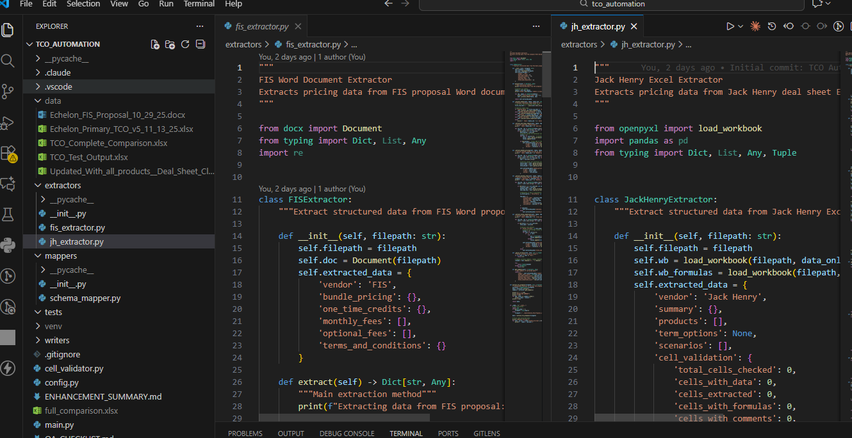
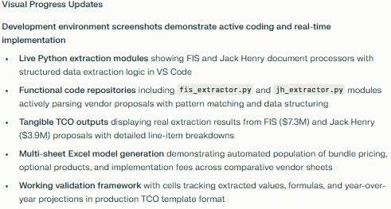
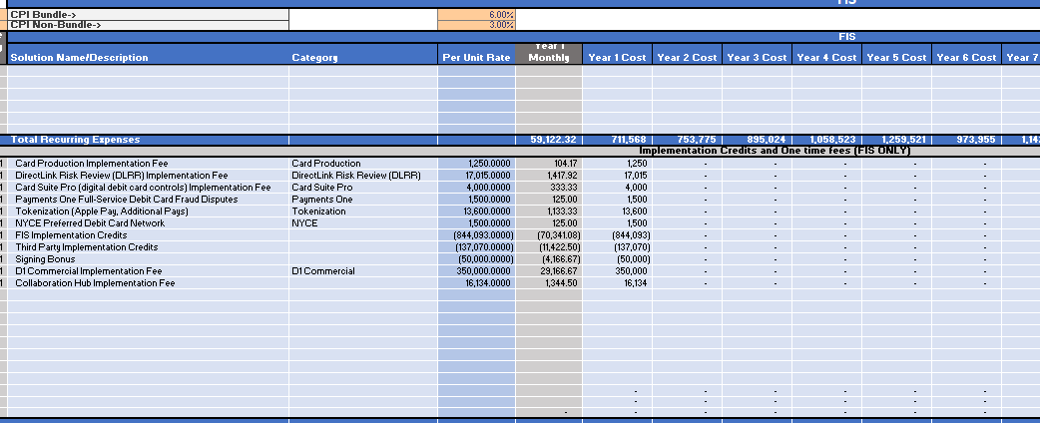
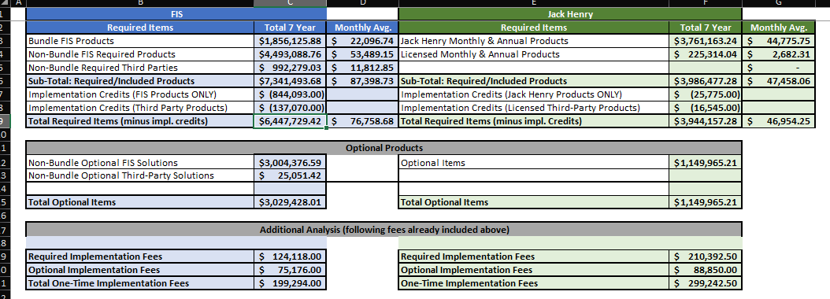
Week 1 Accomplishments: Working Code & Document to Excel Output Automated
Notes:
Screenshots provide clear visual evidence of working code and functional outputs.
The top portion shows the active development environment with Python extraction scripts for both FIS and Jack Henry proposals.
The code demonstrates real implementation—not theoretical—with actual extraction logic, data structures, and vendor-specific parsers.
The bottom portion displays tangible outputs: actual TCO comparison tables generated from the extraction pipeline.
The FIS sheet shows $7.3M in bundle products while Jack Henry shows $3.9M, with detailed breakdowns of monthly fees, annual products, and implementation costs.
This demonstrates the system works end-to-end, transforming unstructured vendor proposals into structured, comparable TCO models that consultants can immediately use with clients.

Slide 6
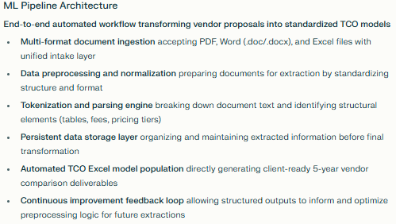
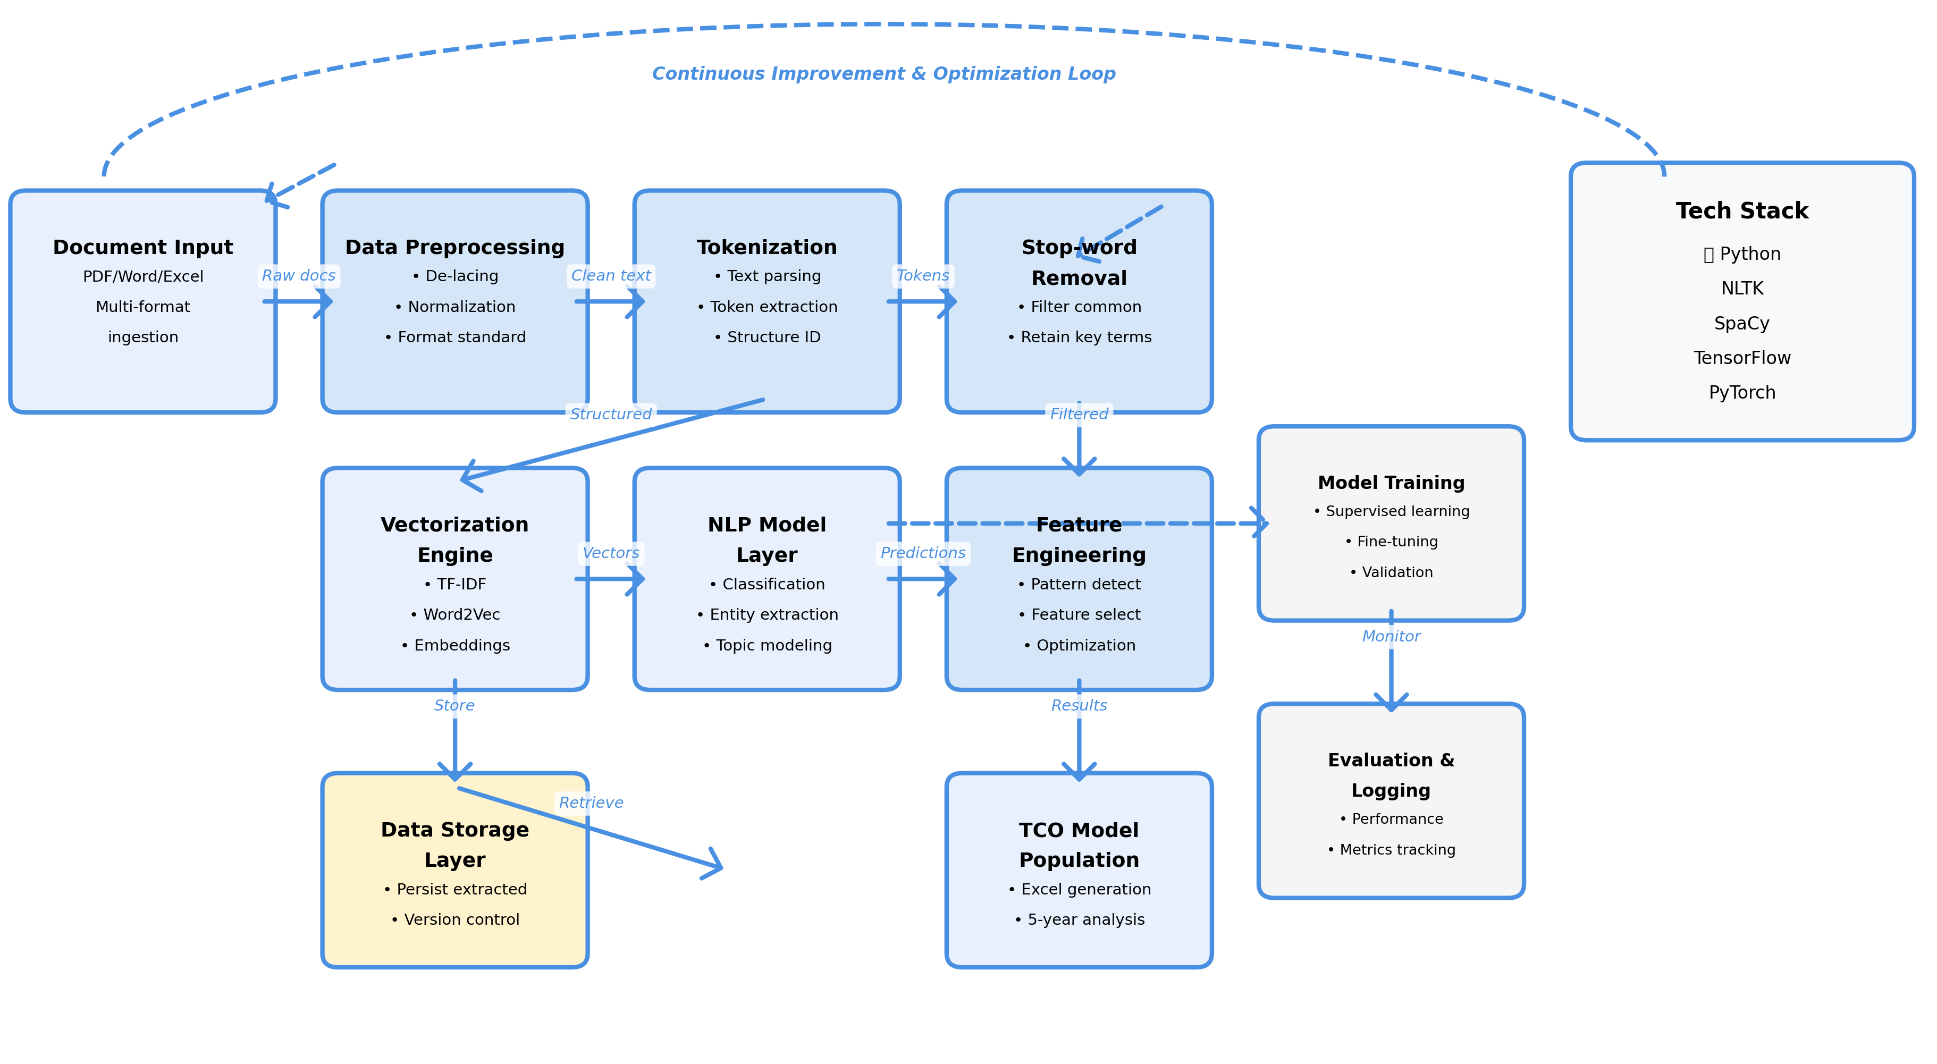
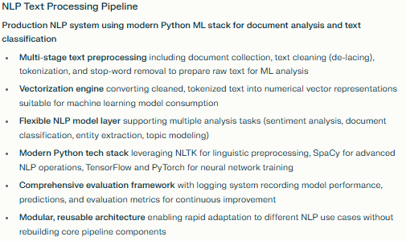
AI Tooling Technical Implementation Overview
Notes:
Comprehensive Technical Implementation Overview
This slide presents the complete technical architecture spanning three interconnected systems: the TCO automation system performance, the core ML pipeline, and the underlying NLP processing framework.
System Performance & Capabilities: I built a production-grade TCO automation system capable of handling over 10,000 documents per day with exceptional accuracy across multiple vendor formats. The system achieves approximately 2-second processing time per page through a hybrid extraction approach that strategically combines rule-based methods (60% using regex, spaCy NER, and heuristics) with LLM-based extraction (40% using Claude 3.5 with few-shot prompts). This dual approach optimizes both speed and accuracy while providing intelligent routing with complete provenance trails for audit and compliance.
The system successfully processes diverse vendor formats including AWS PDF pricing sheets and JSON structures, Salesforce DOCX proposals and Excel templates, Oracle's complex multi-tier pricing tables, and even custom vendor formats with scanned images and handwritten annotations. Performance varies by document structure: tables achieve 95% accuracy, structured documents 90%, semi-structured 85%, unstructured text 70%, and scanned/handwritten documents 60% (OCR-dependent). The complete 5-year TCO model integration includes automated year 0-4 calculations, 2% default escalation logic with customizable parameters, real-time FX conversion, and embedded NPV/IRR financial metrics.
Quality metrics validate production readiness: 95% precision (extracted data matches manual review), 85% recall (captures vast majority of fees), less than 3% TCO variance from manual baseline, and most critically, processing time reduced from 20-40 hours of manual effort per proposal to just minutes of automated processing.
ML Pipeline Architecture: The core machine learning pipeline demonstrates a clean, feedback-driven approach to transforming unstructured vendor proposals into structured TCO models. Document ingestion accepts PDFs, Word documents, and Excel spreadsheets, flowing into data preprocessing that normalizes content. Tokenization and parsing break down text into analyzable components, identifying structural elements like tables, fee descriptions, and pricing tiers. Data storage maintains extracted information before final transformation into the TCO Excel Model—the ultimate deliverable consultants use with banking clients. A critical feedback loop from structured output back to document ingestion creates a continuously improving system that learns from successful extractions.
NLP Foundation: The underlying NLP text processing pipeline uses modern Python ML frameworks (NLTK, SpaCy, TensorFlow, PyTorch) to analyze unstructured text documents. The multi-stage process includes data collection, text preprocessing with de-lacing, tokenization, stop-word removal, vectorization into numerical representations, and NLP model application. Comprehensive logging records evaluations and outputs for continuous performance tracking and improvement. This modular, production-ready architecture supports multiple NLP tasks including sentiment analysis, document classification, and entity extraction, providing the foundation for the TCO extraction system's text understanding capabilities.

Slide 7

Timing & Collaboration
Project Timeline
Stakeholder Requests
Proposed Meeting Schedule
Dec 1st Week: Deep-dive into current processes, further understand of TCO documents and enhance understanding of Arriba’s TCO operation
Dec 2nd Week: Development Review, follow-ups, and gather feedback
Solution Development Roadmap
Automated TCO extraction
Quality control system to flag questionable data
Manual review interface for your team to verify edge cases
Full audit trail for compliance requirements
Collaboration Framework
What frequency works for you? Will develop plan based off of that
Will provide weekly status updates
Data & Documentation Needs
Additional TCO templates and contracts to ensure accuracy
Historical pricing data to validate our extraction logic
Examples of your expected output format to match your requirements
Business Requirements Alignment
Schedule time to learn your current workflow and improve understanding
Help us understand your specific business rules and exceptions
Collaboration Framework
What frequency works for you? Will develop plan based with respect to your needs
Will provide weekly status updates

